Slide 1
Evolutionary Computation COMP 8282 Project Demo Presentation
Kishor datta gupta

Slide 2
Framework
C# dotnet 4.5
No external library for GA
Aforge lib for greyscale filtering

Slide 3
GA
Used tournament method
Elitism
3 point crossover
Mutation rate min 15%
Initial population 24
Per chromosome size imagesize*imagesize bit string consist of 0 and 1
3 fitness objective

Slide 4
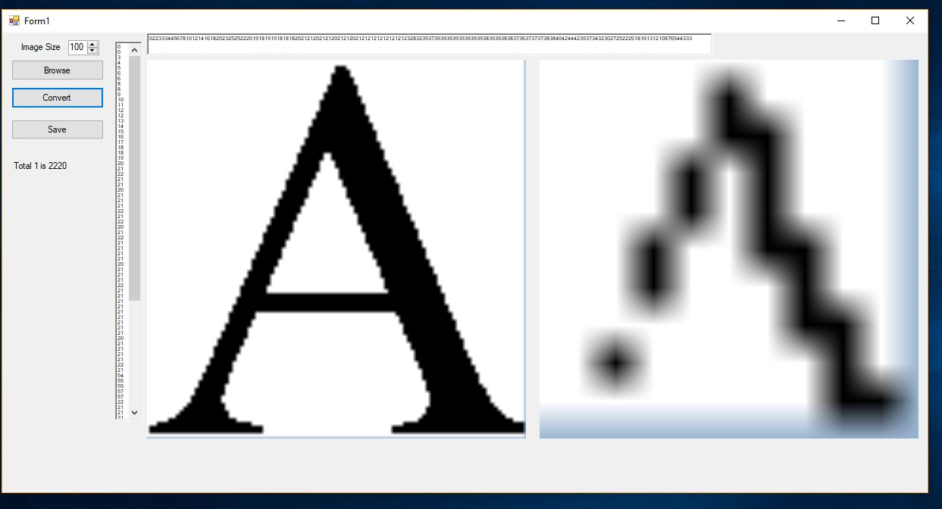
Image resized

Slide 5
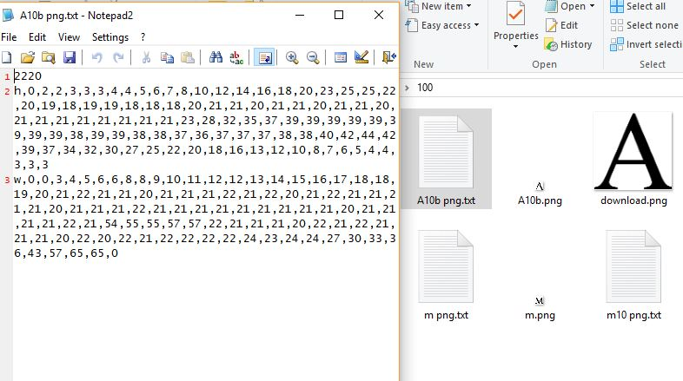
Additional Data

Slide 6
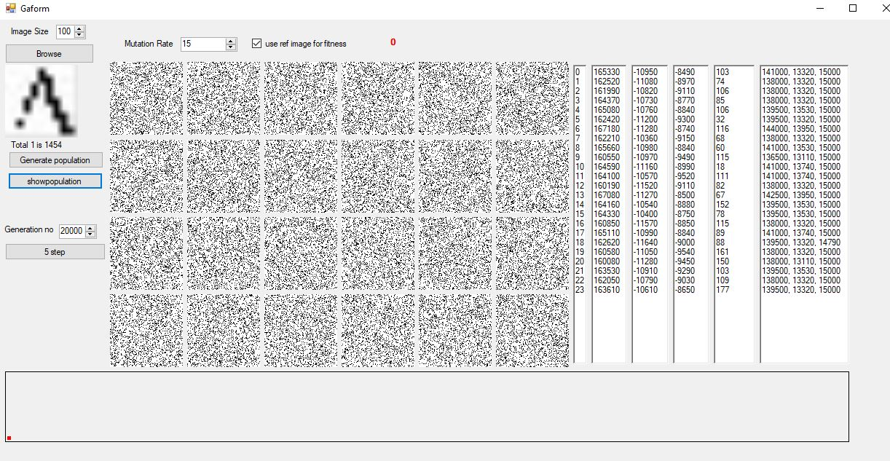
Initial population

Slide 7
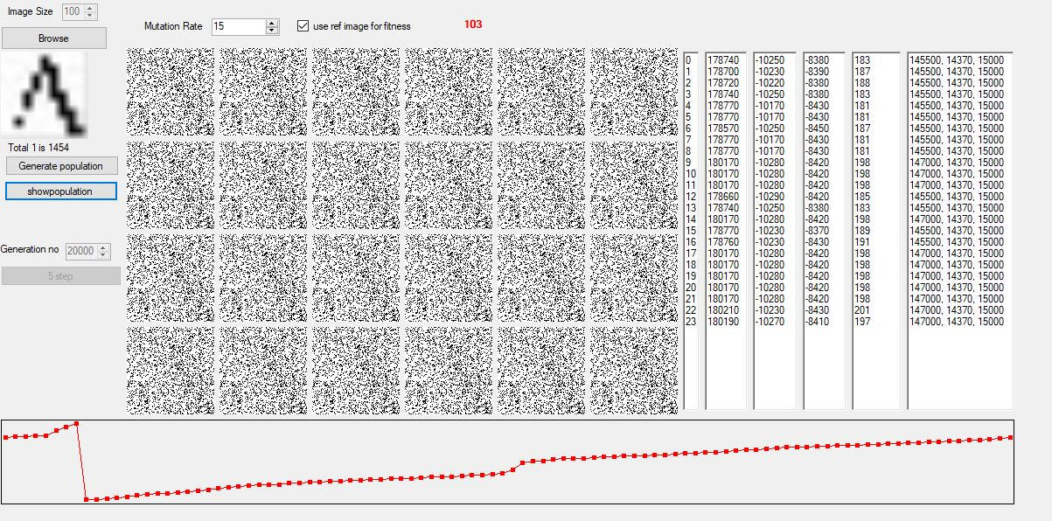
Generation

Slide 8
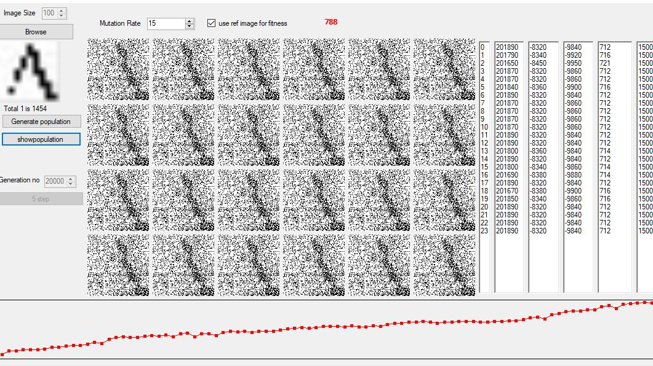
Generation

Slide 9
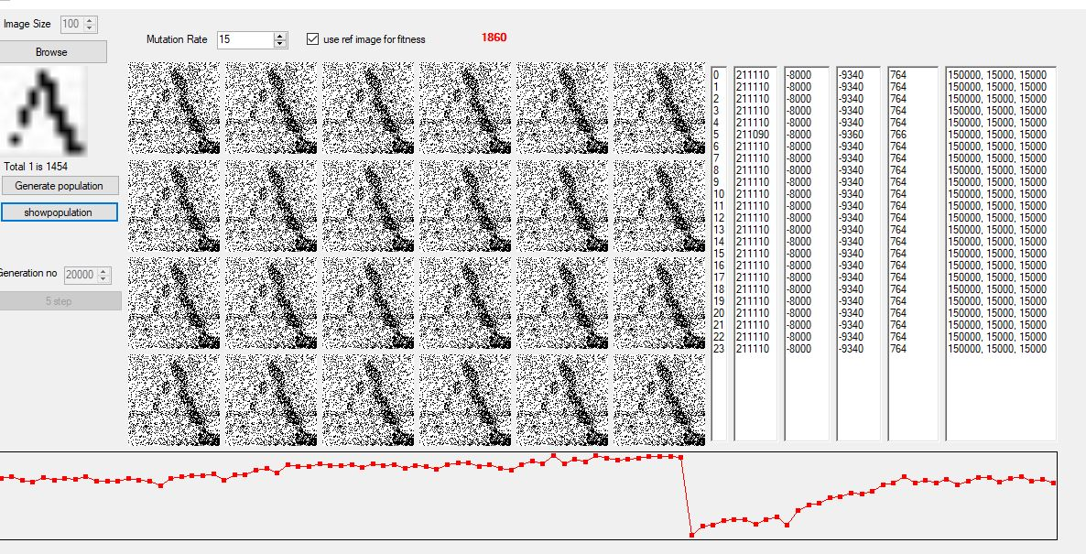
Generation

Slide 10
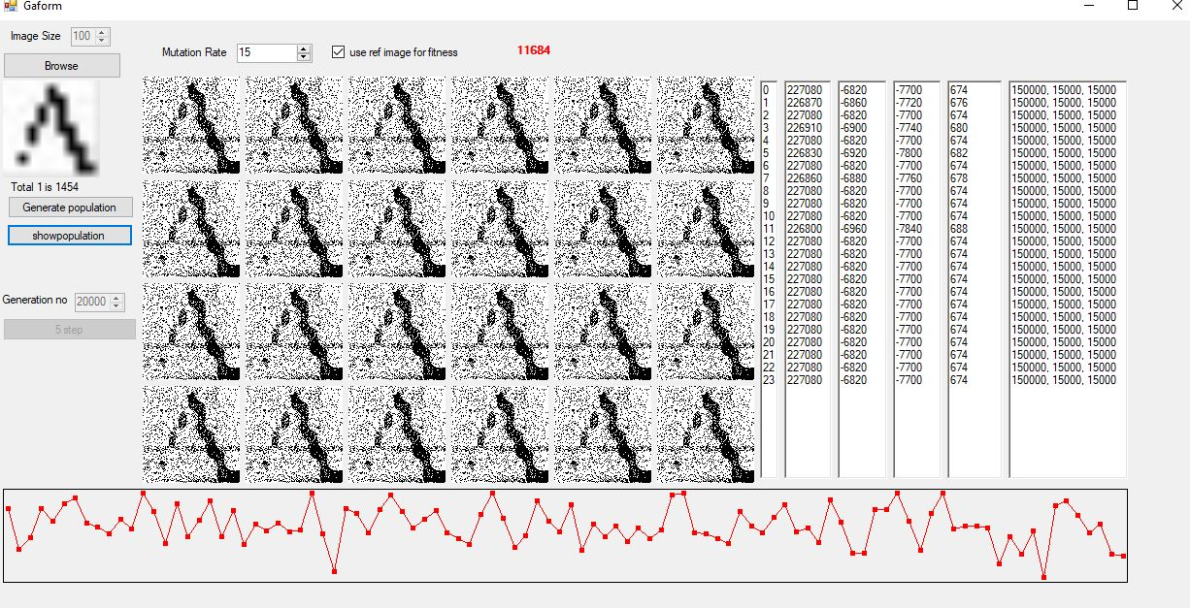

Slide 11
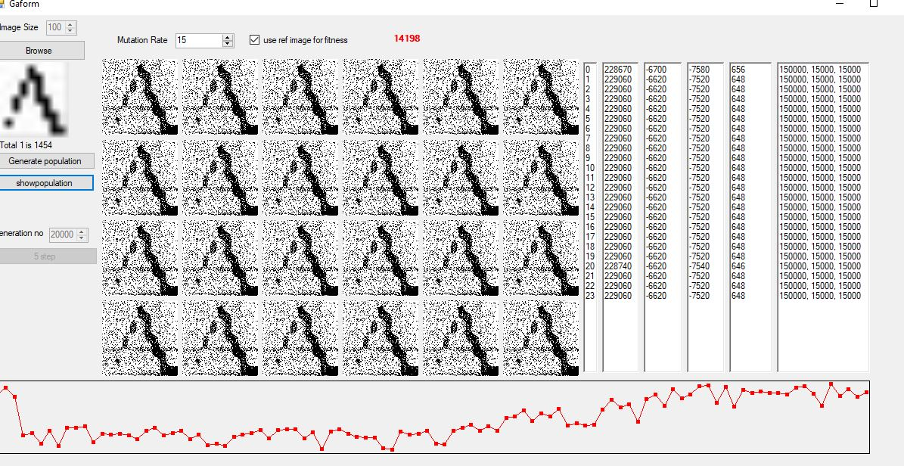

Slide 12
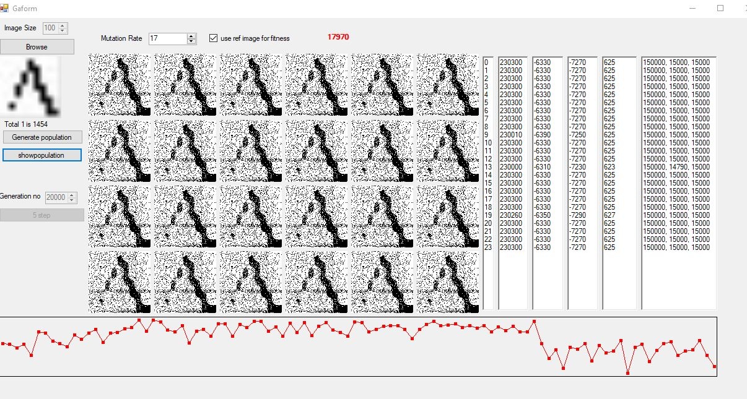

Slide 13
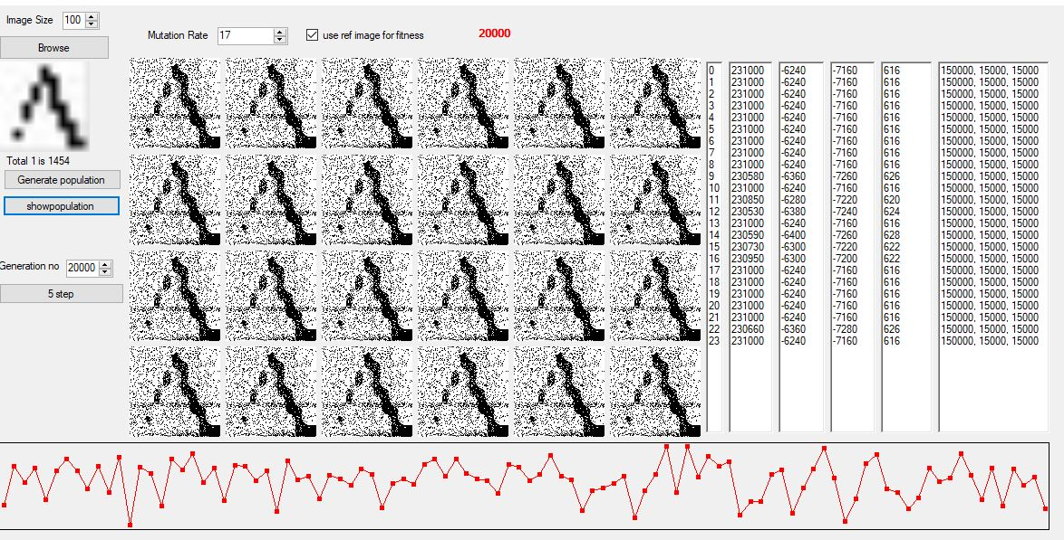

Slide 14
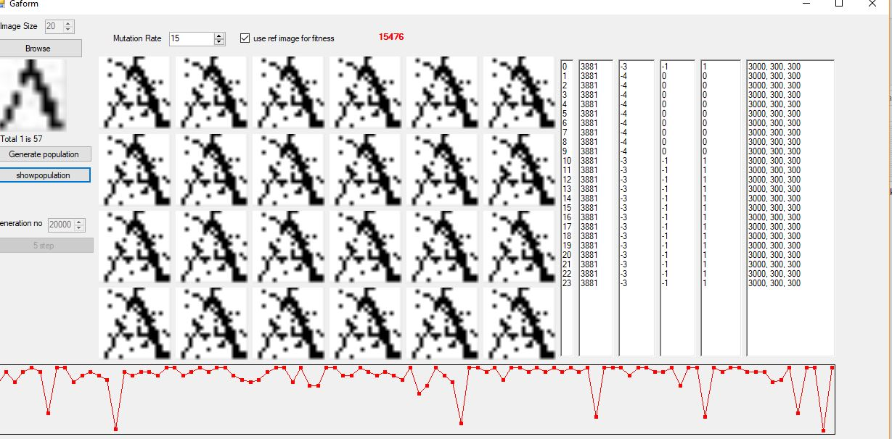
With 20 size

Slide 15
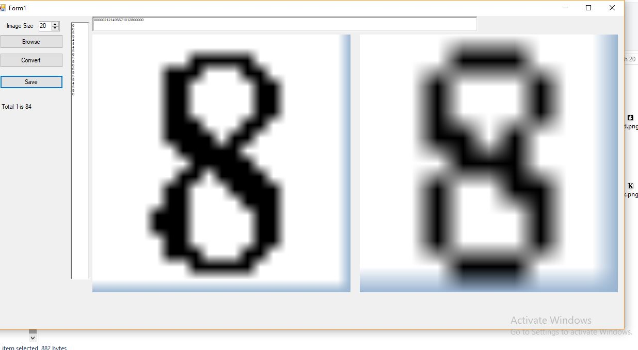
Without image

Slide 16
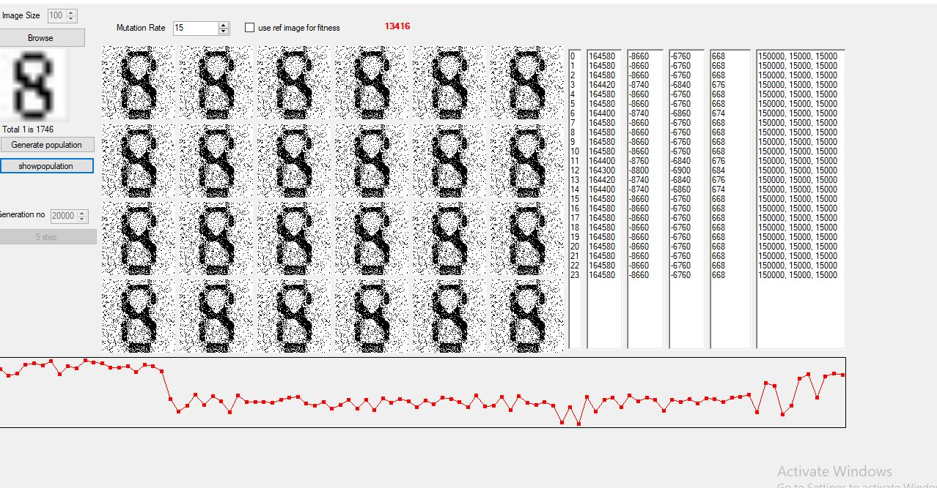
Without image

Slide 17
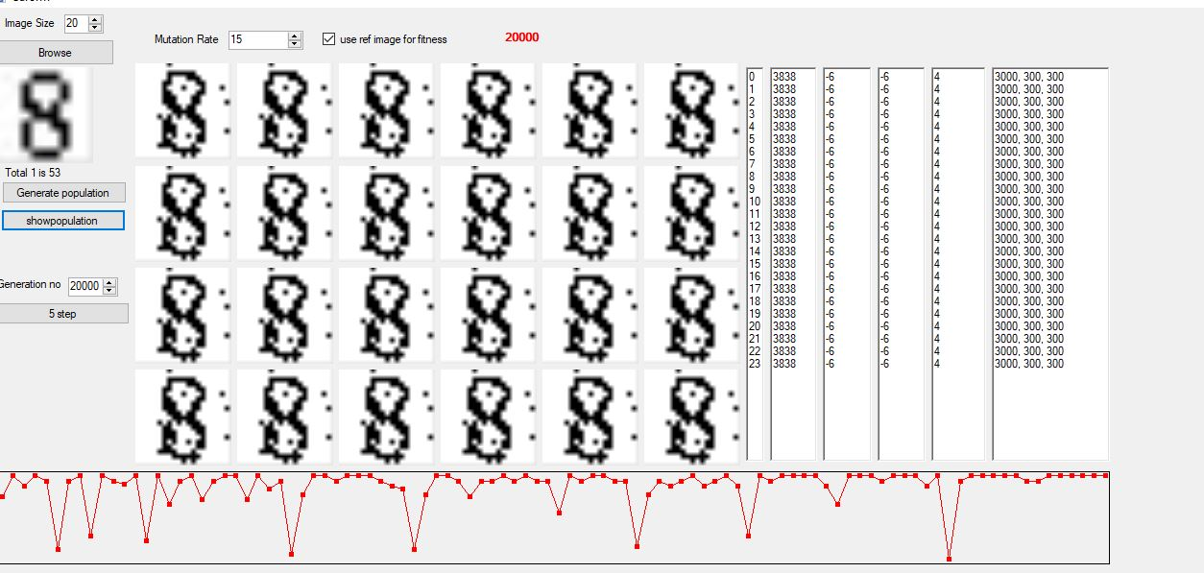
With image

Slide 18
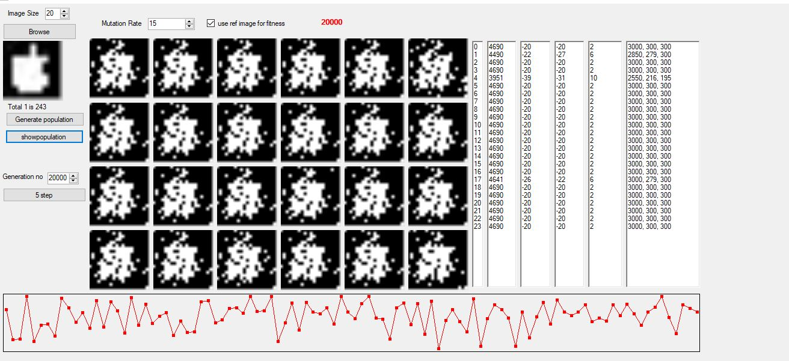
Apple image

Slide 19
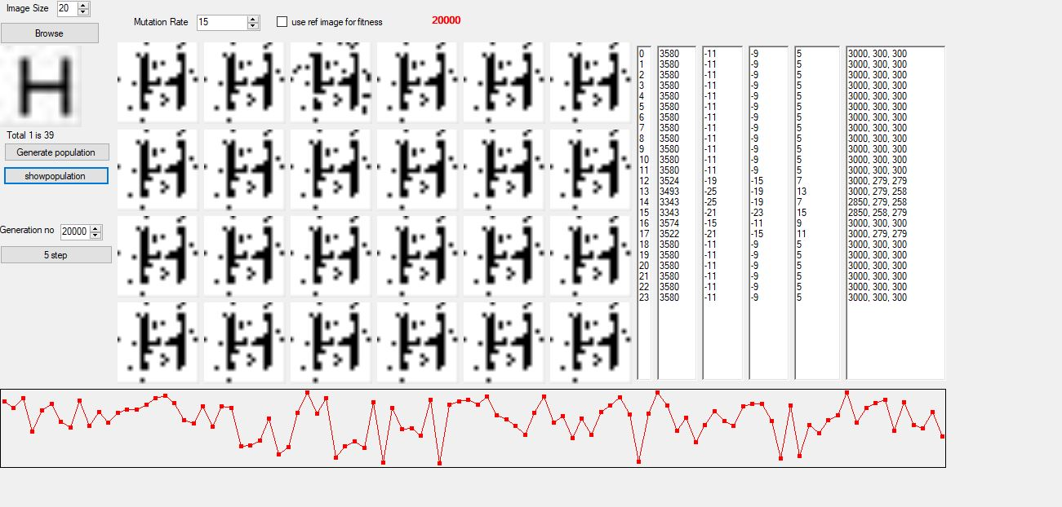
Without image

Slide 20
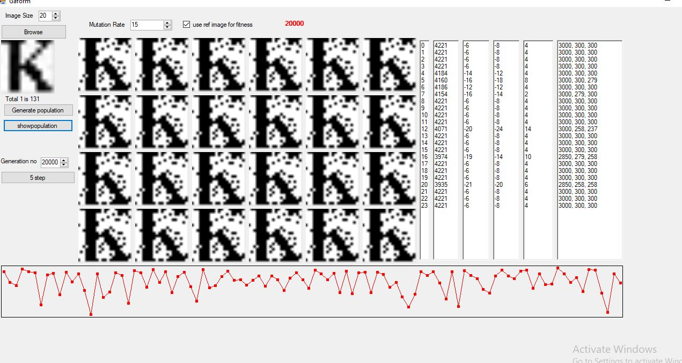
Issue

Slide 21
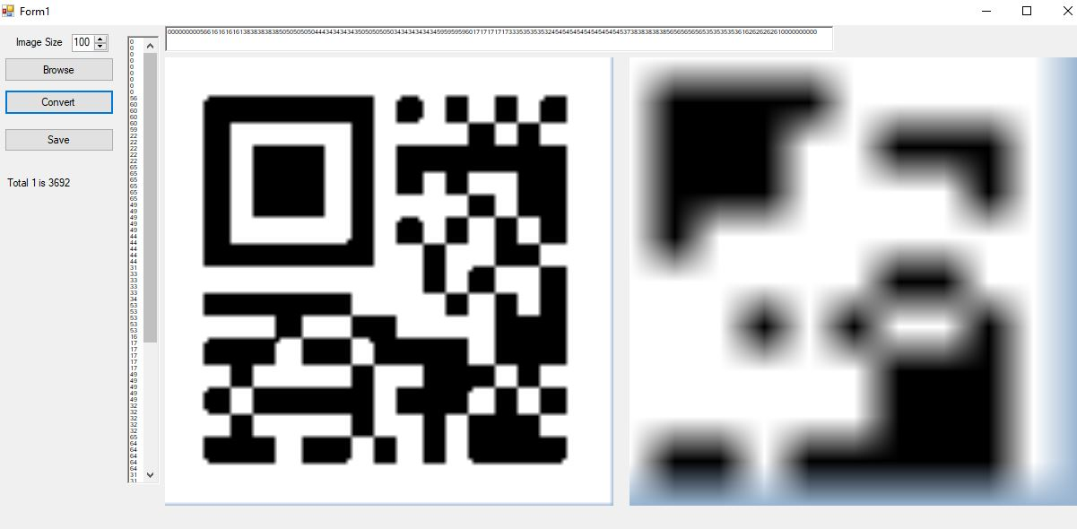
QR

Slide 22
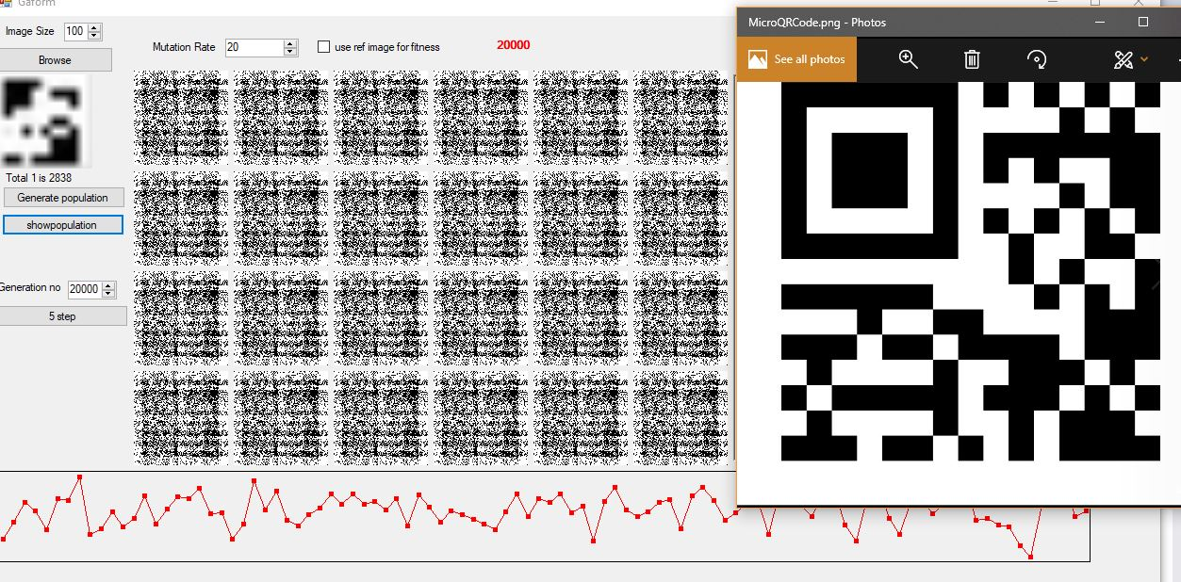
QR result

Slide 23
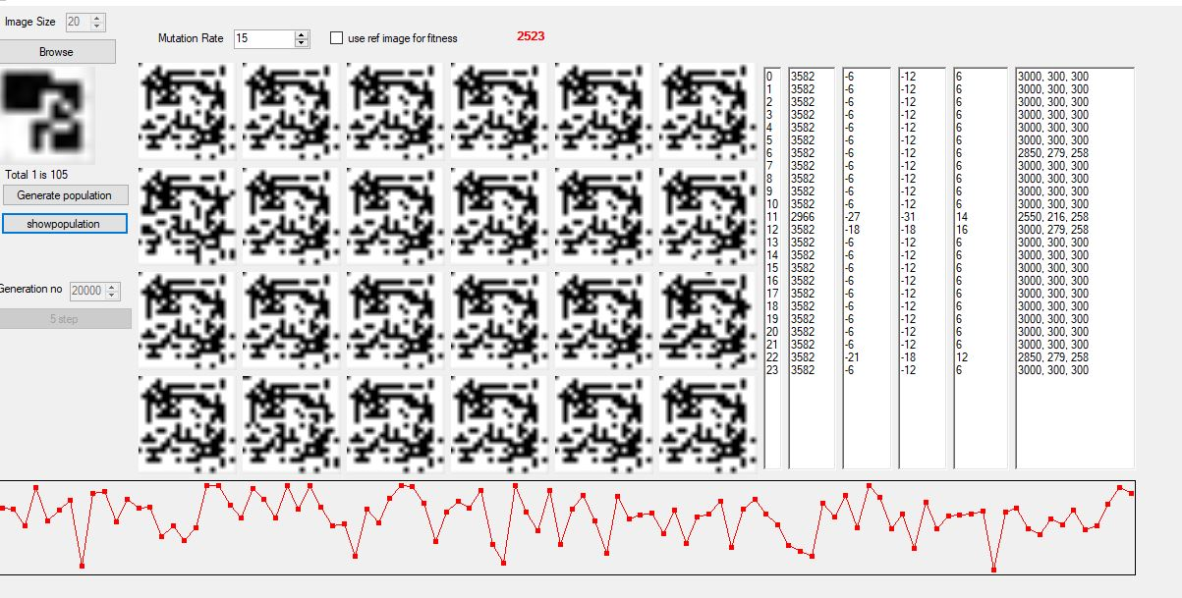
QR result

Slide 24
DEMO

